Slide 1
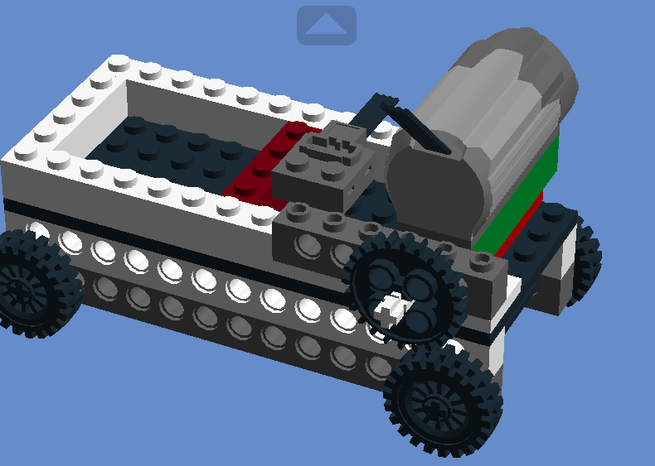
Платформа на колесах

Slide 2
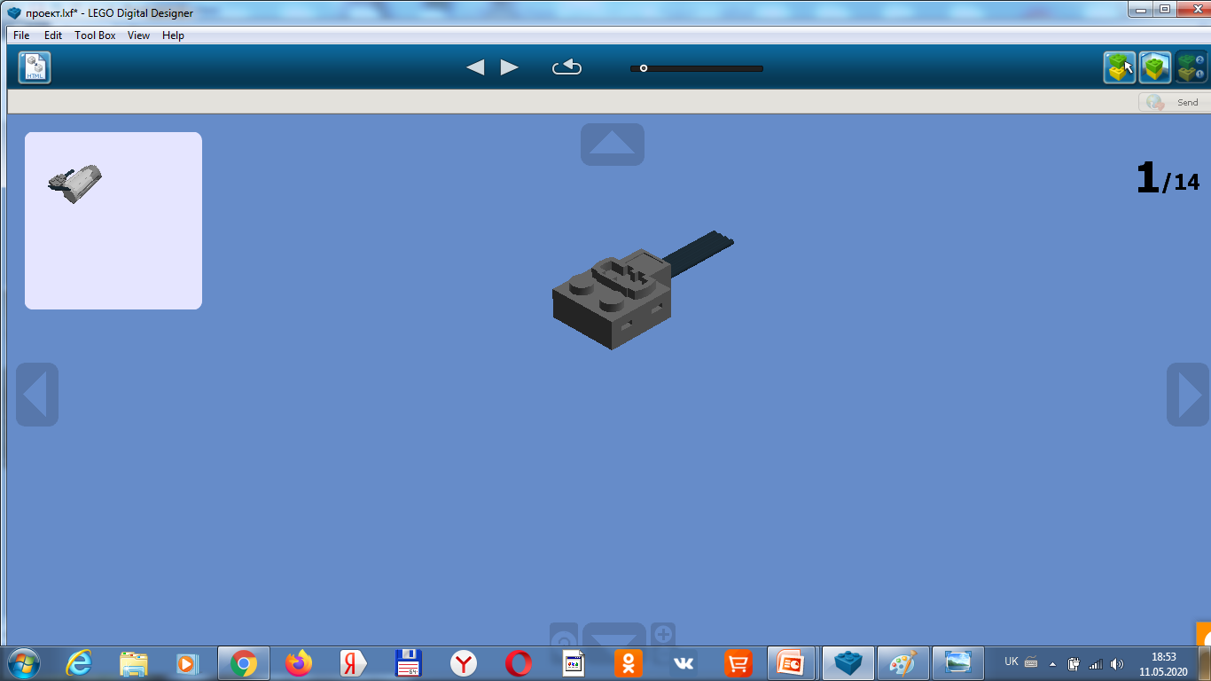
FUNC.MOTOR 24X6

Slide 3
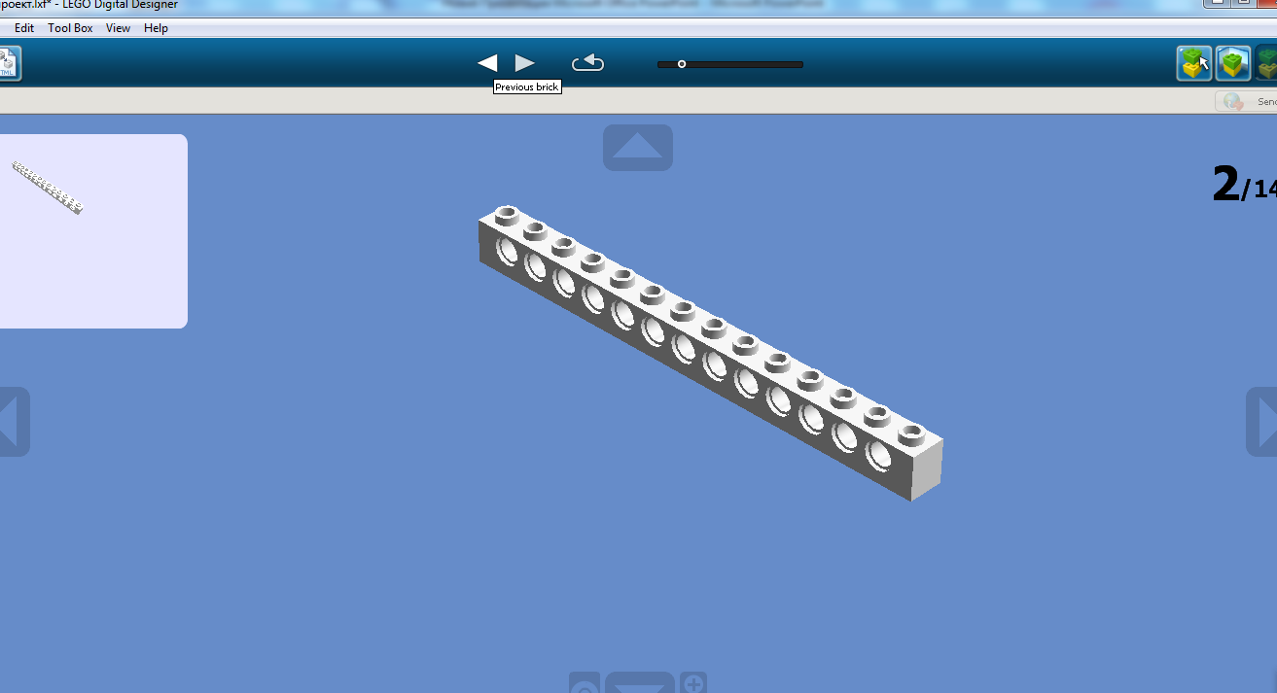
TECHNIC BRICK 1X14

Slide 4
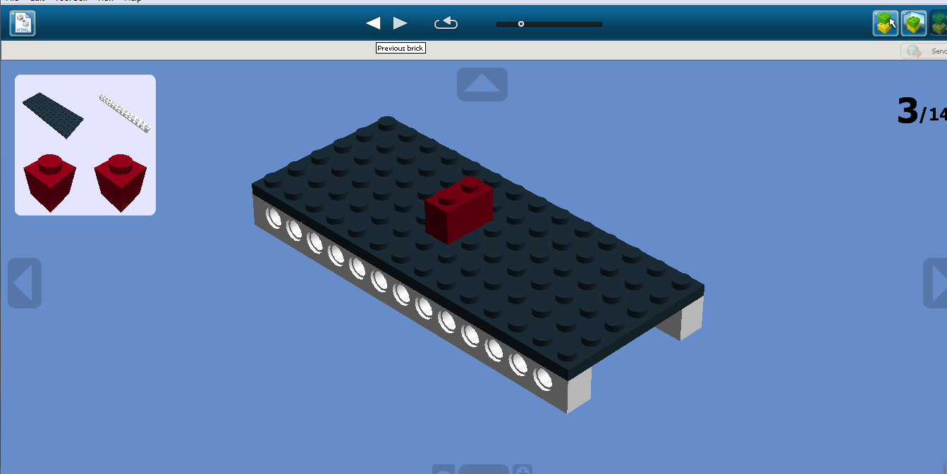
PLATE 6X14
TECHNIC BRICK 1X14
BRICK 1X1

Slide 5
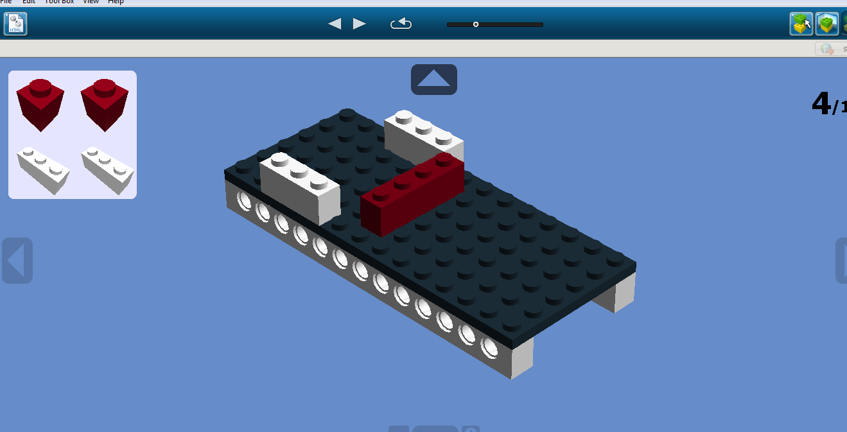

Slide 6
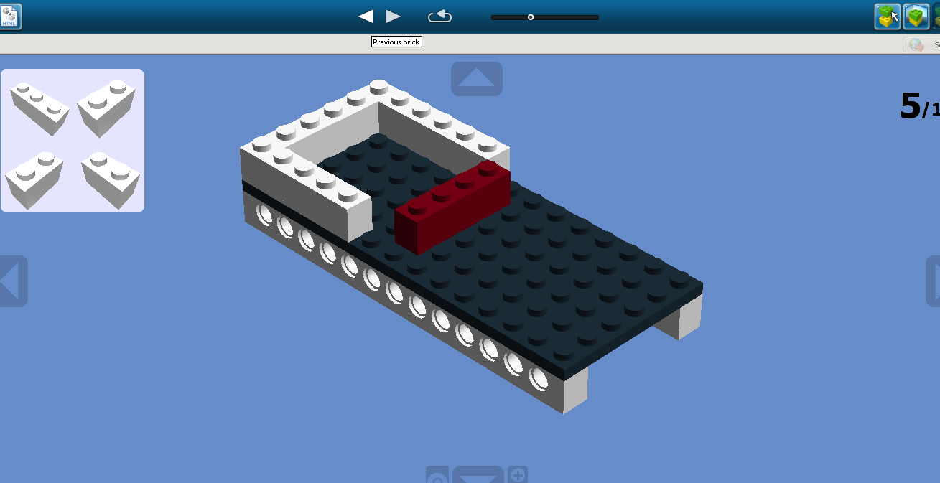
BRICK 1X3
BRICK 1X2

Slide 7
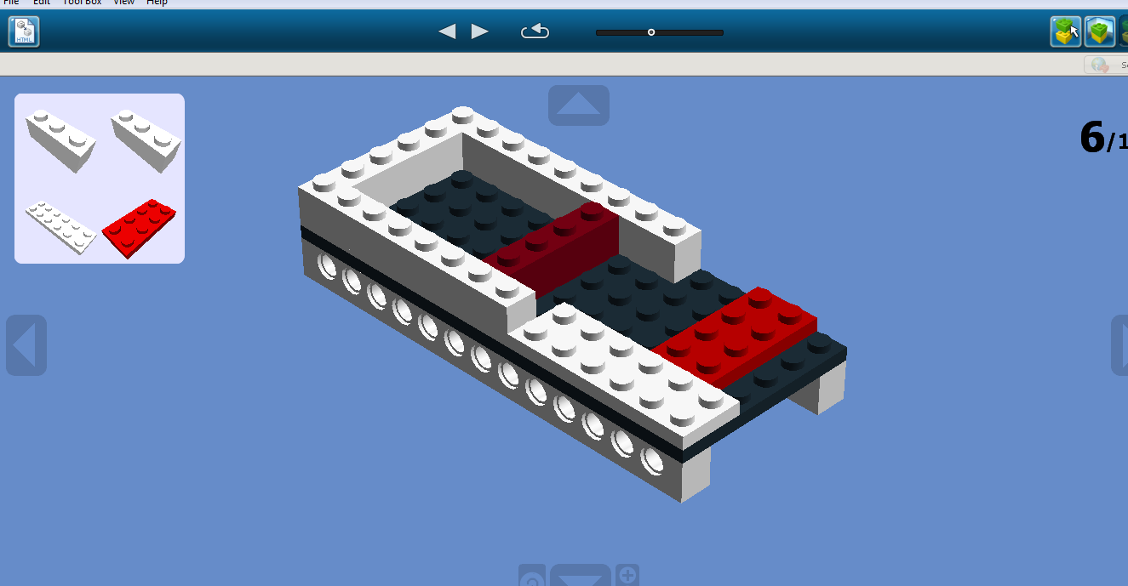
BRICK 1X3
PLATE 2X6
PLATE 2X4

Slide 8
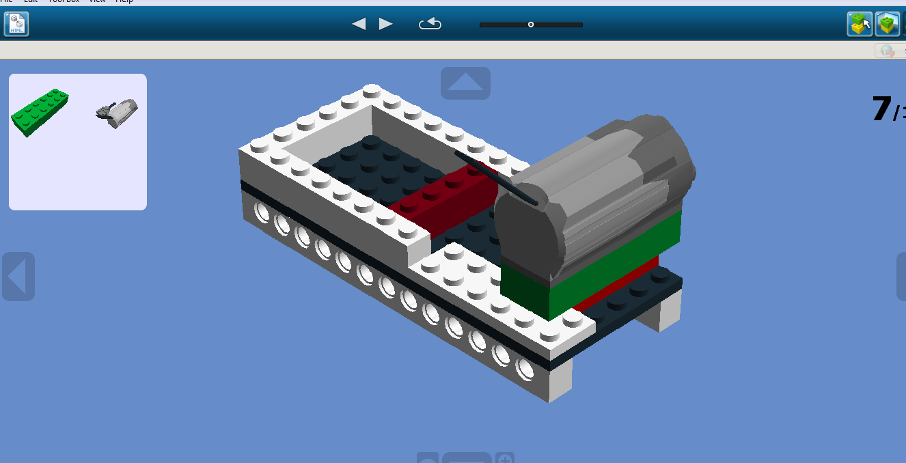
FUNC.MOTOR 24X6
BRICK 2X6

Slide 9
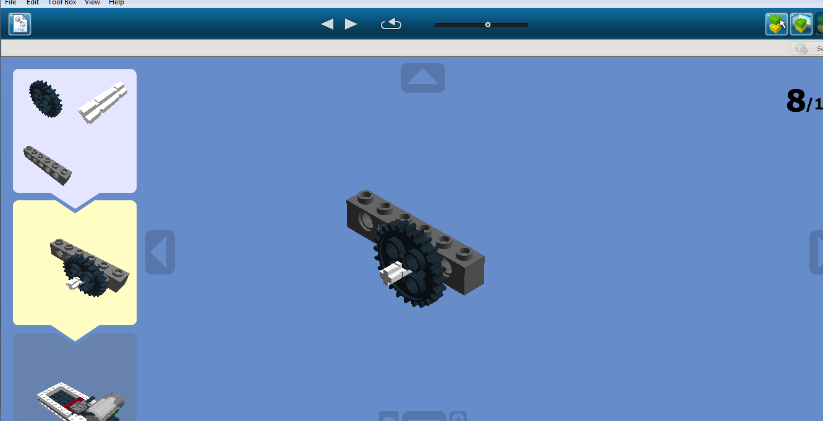
GEAR WHEEL Z24
2 M CROSS AXLE W
TECHNIC BRICK 1X6

Slide 10
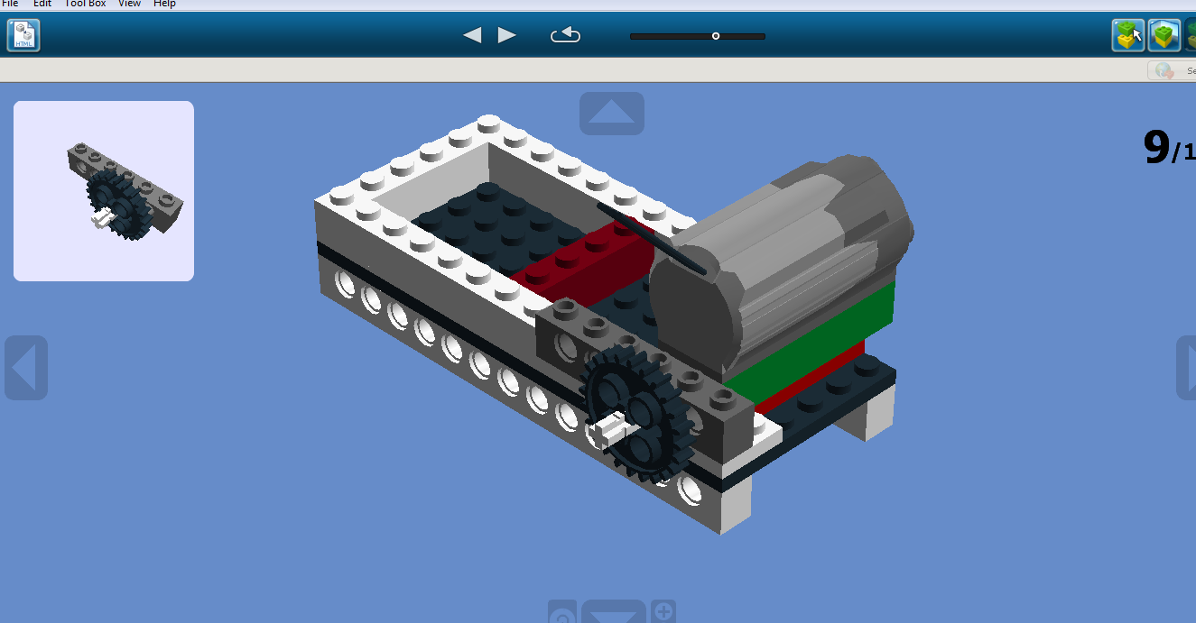

Slide 11
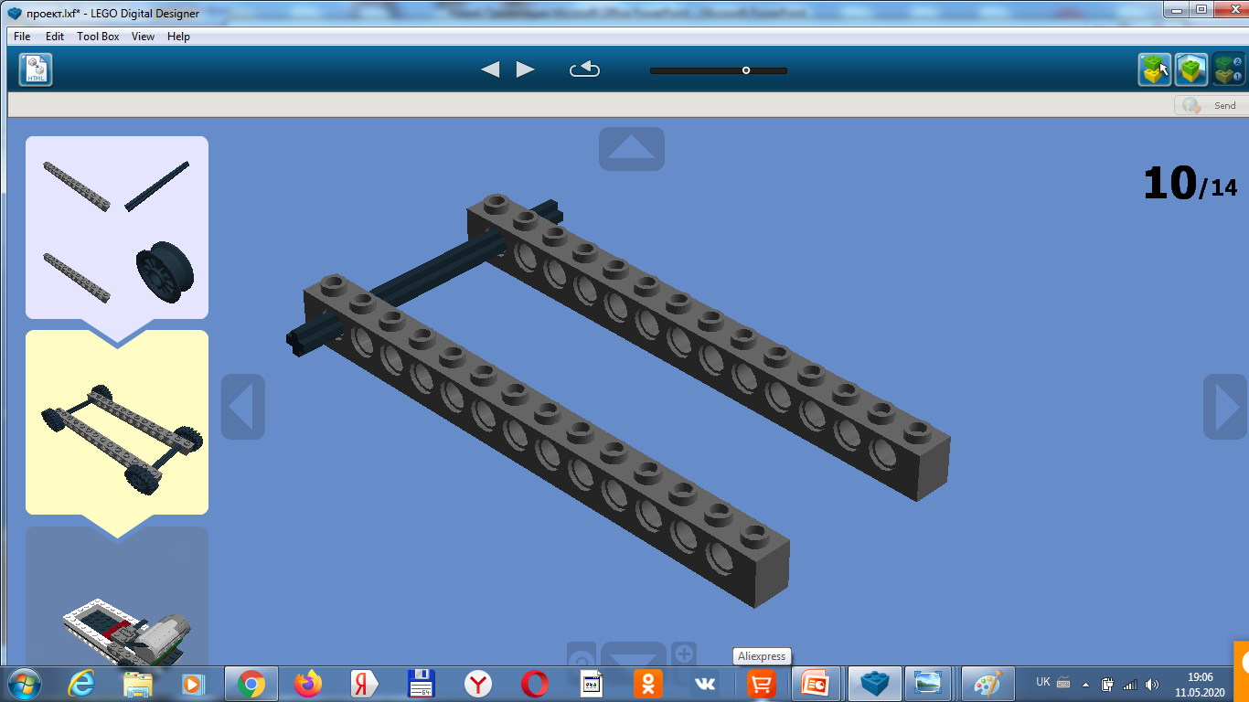
CROSS AXLE 8M
WHEEL HUB W
TECHNIC BRICK 1X6

Slide 12
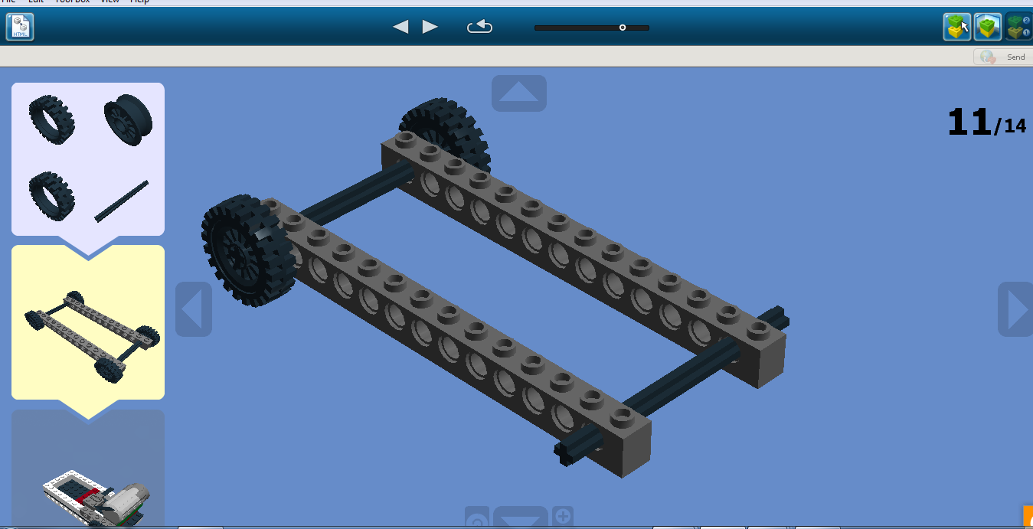
WHEEL HUB W
CROSS AXLE 8M
TYRE LOW NARROW 24X7 MM

Slide 13
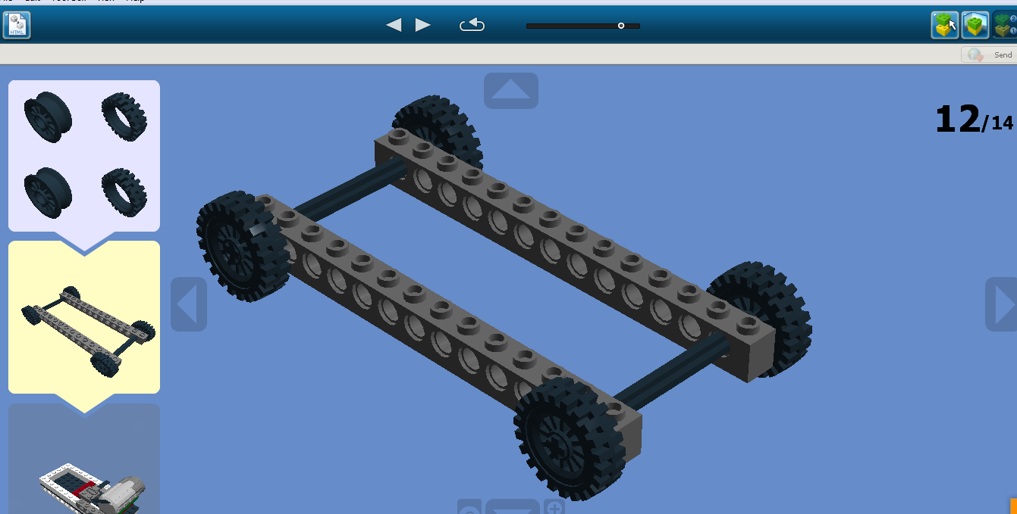
TYRE LOW NARROW 24X7 MM
WHEEL HUB W

Slide 14
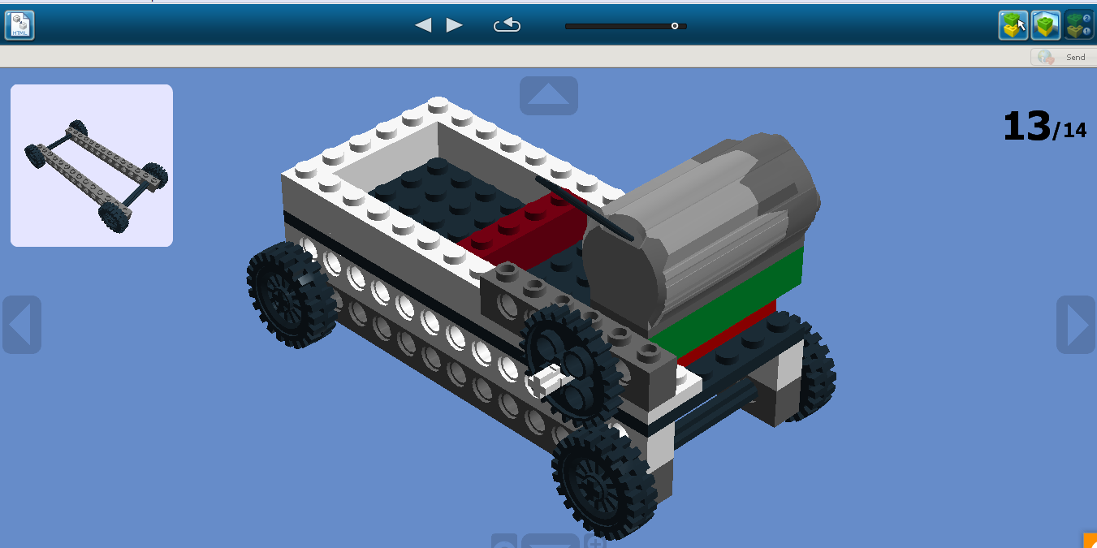

Slide 15
